Slide 1
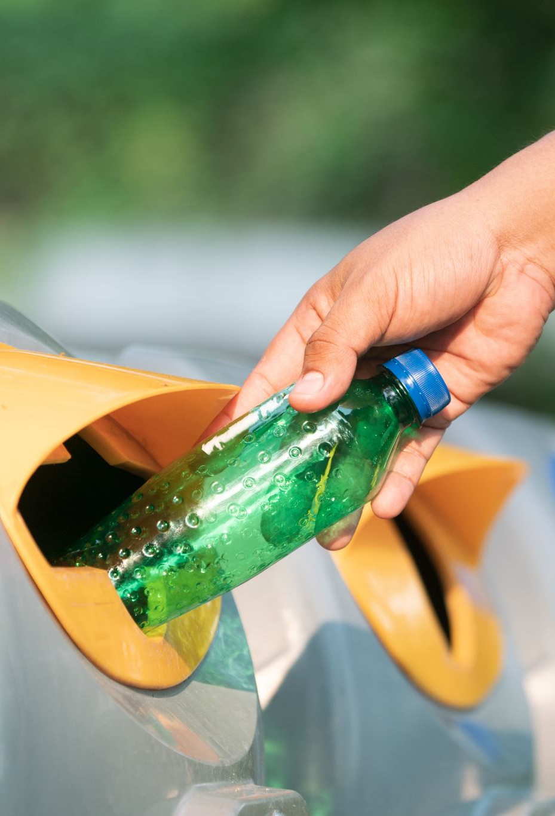


Earth Keepers
Raeed Ataria 212154629
&
Suhel khoury 212103527

Slide 2

Agenda
Problem
Requirements
Our solution
Challenges
Tools
6. Datasets
7. UML Diagrams
8. Testing
9. Training & Results
10. Success Criteria
11. Constraints
12. Conclusion

Slide 3

Requirements
The system allows the user to login into his account.
The system allows the user to sign up for a new account.
The system allows the user to start a session of collecting trash.
The system allows making sounds.
The system allows counting the points of the picked up trash items.
The system allows the user to end the session whenever he wants.
The system allows presenting the total collected points to the user after the session.
The system allows the user to view his profile.
The system allows the user to edit his profile.
The system allows the user to view score tables.

Slide 4
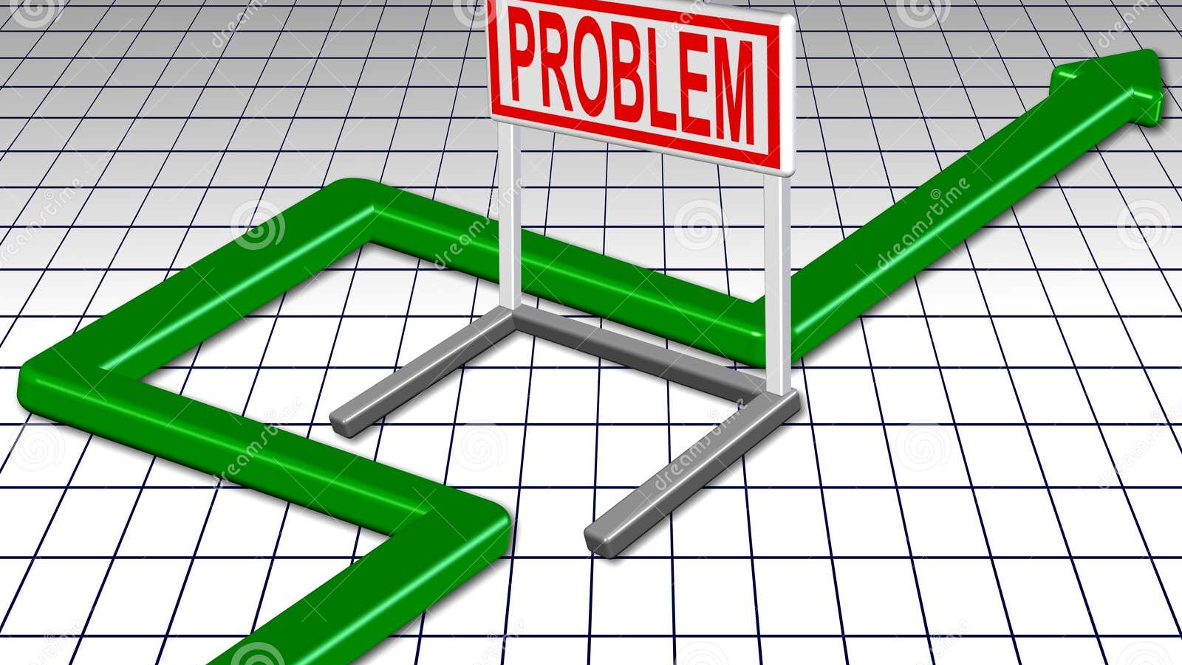
Problem

Slide 5
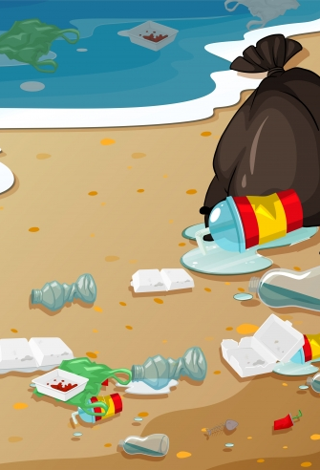
Environmental Neglect: The Rise of Uncollected Trash
Increasing prevalence of uncollected trash on beaches and public places
Poses severe environmental threat demanding immediate attention
Rooted in human negligence and lack of community engagement
Urgent need to address the lack of interest in trash collection to protect our planet

Slide 6

Our Solution

Slide 7
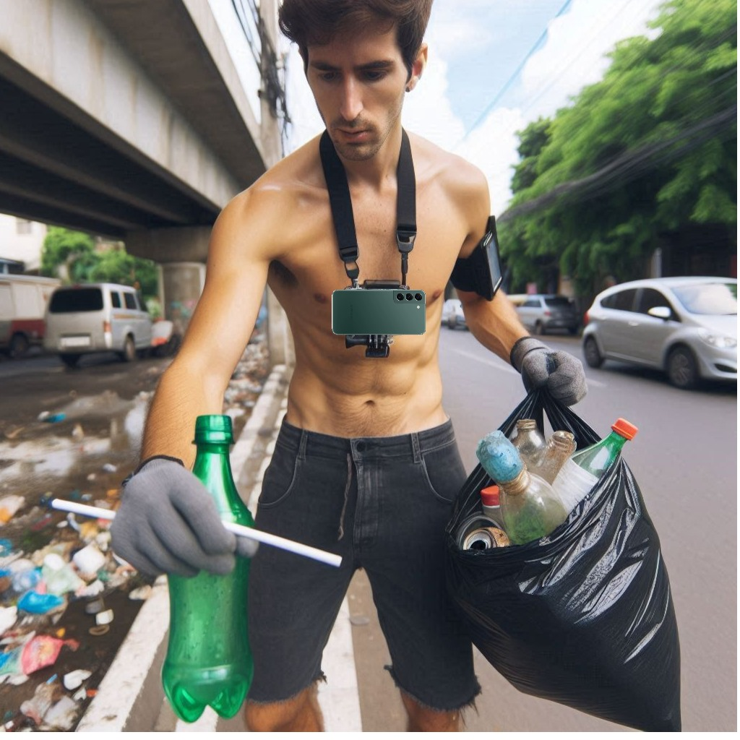
Earth Keepers App
Our project introduces an innovative solution for waste collection, blending gamification with technology
Using an Android app powered by machine learning and body cameras, we detect and categorize trash in real-time
Participants earn points for each collected item, making the process engaging and rewarding

Slide 8

Challenges
High accuracy and low latency were required for trash detection on Android.
Mobile devices have limited computational power, making real-time processing difficult.
Solution:
Integrated YOLOv8s for speed and accuracy.
Trained on a customized dataset of 9 trash classes.
Optimized model to run efficiently on Android.

Slide 9
Challenges
Imbalance and variability in the dataset
Solution:
Applying data augmentation techniques, which artificially expand the dataset and make it more robust.
These techniques helped the model become more resilient to different real-world scenarios and improve overall accuracy.

Slide 10
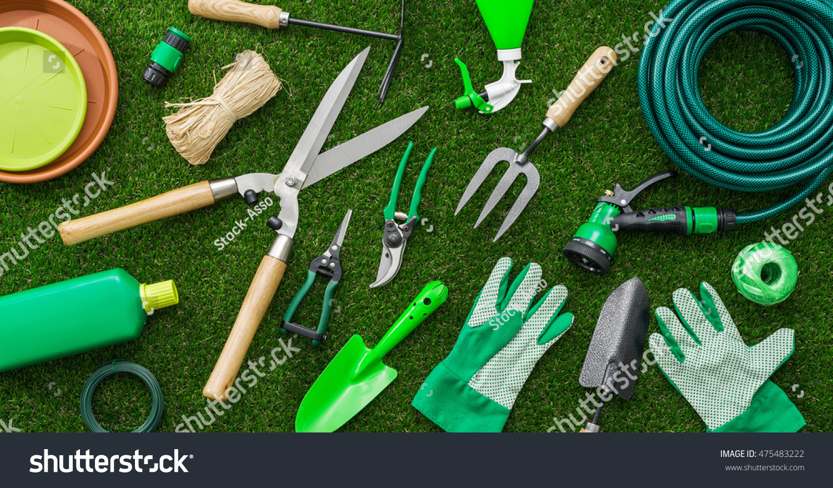
Tools

Slide 11
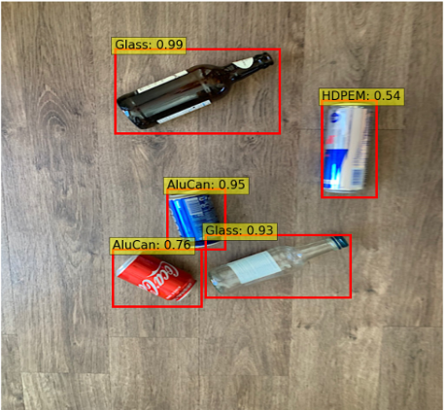
YOLOv8 (You Only Look Once)
One of the best object detection algorithms
Improvement compared to previous versions
Motive:
Detecting trash objects

Slide 12
YOLOv8 models
The models differ in the number of layers and parameters, which affect:
Accuracy
Inference speed
YOLOv8s is well known for its balance between accuracy and speed
making it the perfect choice for real-time apps
Inference Speed | Accuracy | Model
Fastest | Lower | Nano
Fast | Moderate | Small
Moderate | Higher | Medium
Slow | High | Large
Slowest | Highest | Extra Large

Slide 13
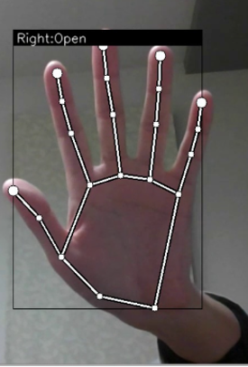

MediaPipe
Hand Tracking real-time module
Motive:
Identifying the pose of grabbing an object

Slide 14
DataSets – DataSets for YOLO
Waste types including paper, glass, plastic, metal, and organic materials.
Reason: Commonly found in public spaces with significant environmental impacts.
9 Classes: Can, Glass Bottle, Paper Cup, Peel, Plastic Bag, Plastic Bottle, Plastic Cup, Snack Wrapper, Tissue.
Purpose: Represents common trash with distinct disposal needs.

Slide 15
YOLO Dataset Composition
Contains 5,500+ original images.
Variety: Different conditions and environments to improve generalization.
Distribution: 80% Training, 10% Validation, 10% Testing.
Performing augmentation like Flip, Crop, Rotation, Saturation, Blur, Noise
Augmented dataset contains 15,000+ images.

Slide 16
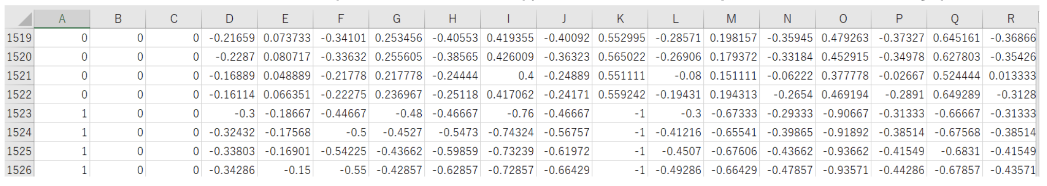
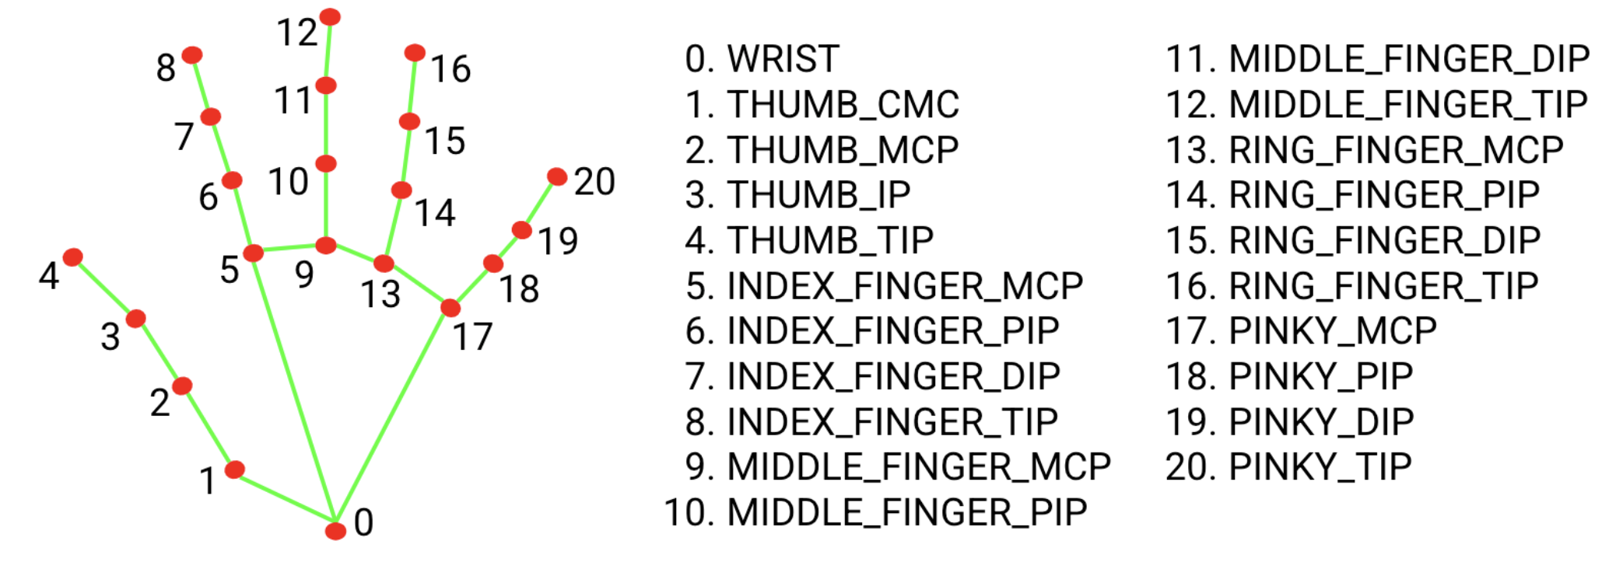
DataSets – Dataset for MediaPipe
1st column Value:
Open hand - Class ID: 0
Close hand – Class ID: 1
Each pair of columns displays the coordinated of a specific key point of the hand
The coordinates undergo with multiple preprocessing steps

Slide 17
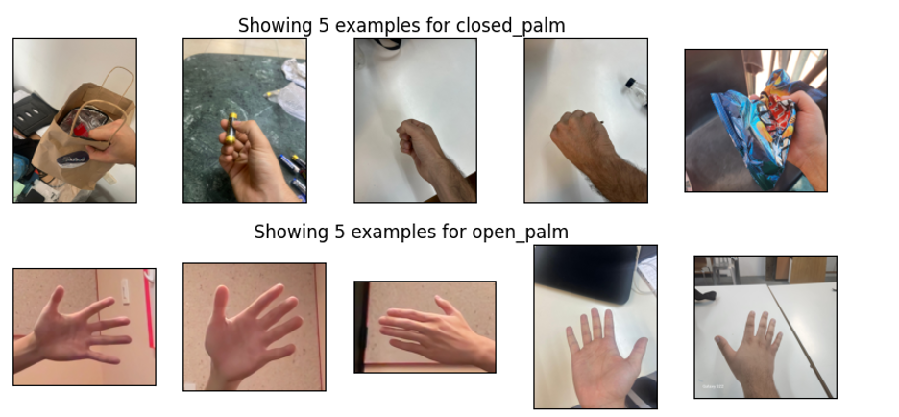
DataSets – Dataset for MediaPipe
Contains: 987 images of open hands
1000 images of closed hands

Slide 18
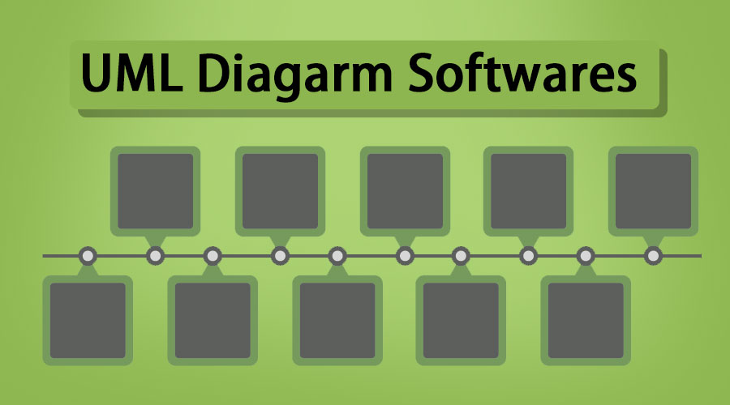
UML Diagrams

Slide 19
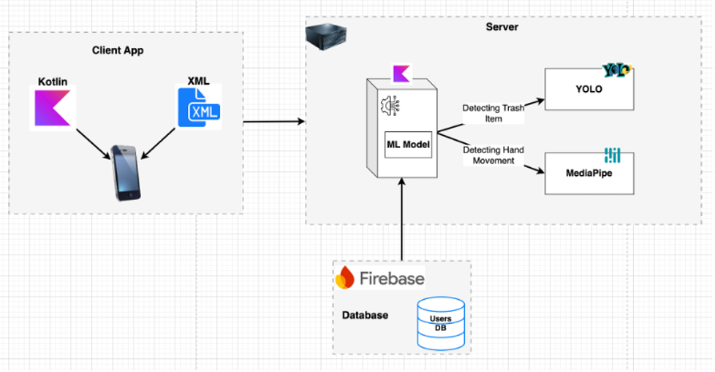
Architecture Diagram

Slide 20
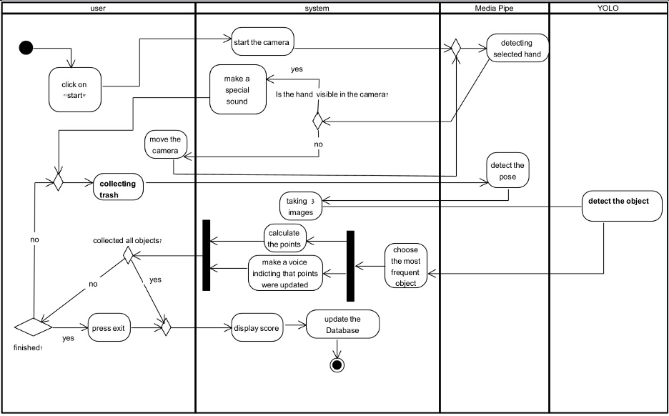
Activity Diagram

Slide 21
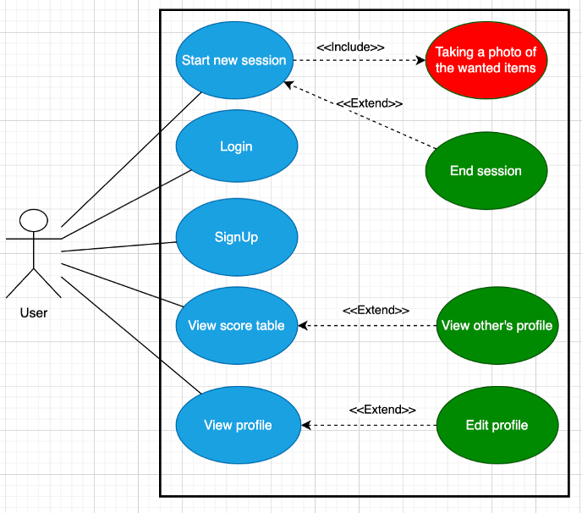
USE Case Diagram

Slide 22


Slide 23
Testing
NUM | Test | Expected Result | Achieved Result
1 | Test the accuracy of trash item recognition | The system succeeds with 95% accuracy | The system succeeds with 97% accuracy
2 | Test hand detection with different skin tones and hand sizes | The system is not biased towards specific hand’s data in 85% of the cases | The system is not biased twoards specific hand’s data in 87% of the cases
3 | Test the accuracy of the counting mechanism in counting the earned points | The system accurately counts the earned points | The system accurately counts the earned points

Slide 24
Testing
NUM | Test | Expected Result | Achieved Result
4 | Test the storing of the earned points in the DB | The system successfully saves the points in DB | The system successfully saves the points in DB
5 | Test the full process of collecting the trash and getting the points | The system succeeds in the integration part with 85% accuracy (worst case) | The system succeeds in the integration part with 87% accuracy (worst case)

Slide 25
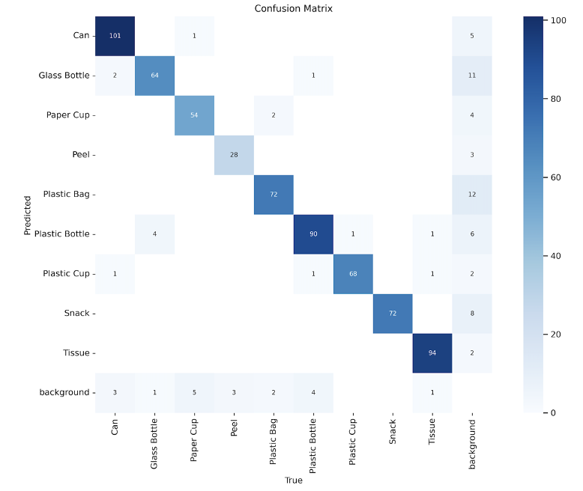
Training YOLO Results
The model demonstrates good overall performance.

Slide 26
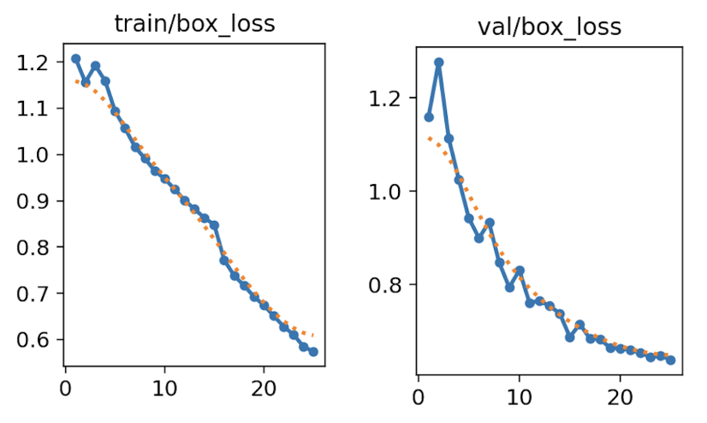
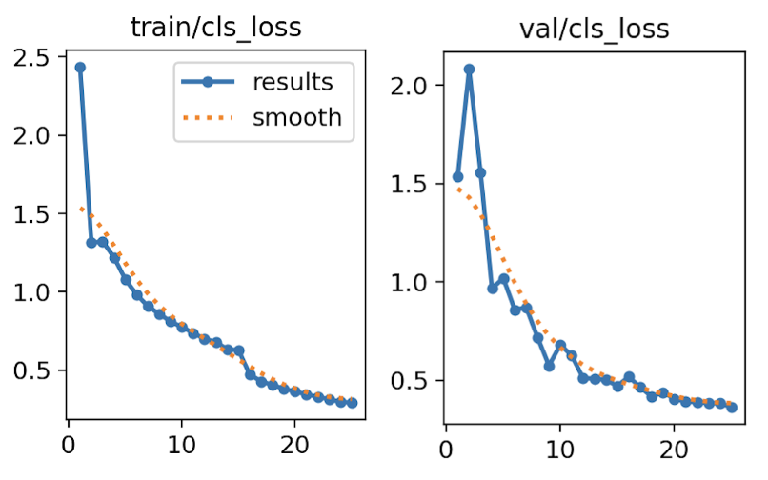
Training YOLO Results
Good Performance: learning effectively.
No Overfitting: good generalization to unseen data.

Slide 27
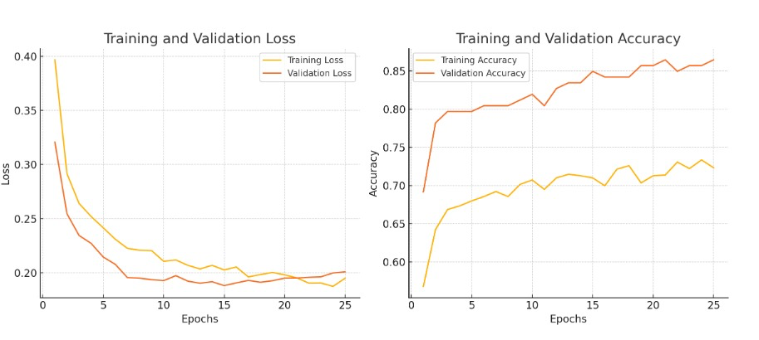
Training MediaPipe Results
Good Performance: learning effectively.
No Overfitting: good generalization to unseen data.

Slide 28

Accuracy:
Goal: >90% accuracy for object detection.
Achievement: YOLOv8 achieved 97% accuracy in trash detection.
Hand gesture recognition met the requirement for detecting hand grabs.
User Interface:
A user-friendly interface was successfully implemented, enabling easy navigation and real-time feedback.

Slide 29
Efficiency:
Goal: Process trash items in 1 second.
Actual: Processing took ~2 seconds/item, but the system was still efficient enough for smooth real-time usage.

Slide 30
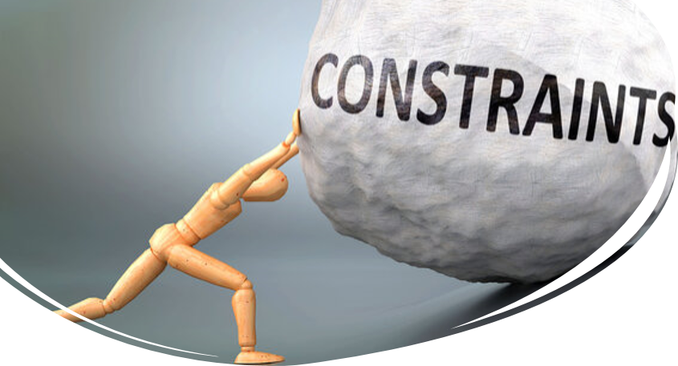
Constraints
Hardware Limitations
Older devices with limited processing power and memory
Environmental Factors
Unpredictable conditions: Varying lighting and background clutter

Slide 31

Conclusion
Our app represents a significant step for reducing uncollected trash
By achieving accuracy, efficiency, friendly UI, and gamification elements
We created an effective solution to encourage community-driven environmental cleanup efforts

Slide 32


